Slide 1

Domestic Violence
against Woman
September 23, 2021 Ayiti Analytics final project Cohort may-september 2020
It’s important to sexually
educating our children

Slide 2

Context
In Haiti, domestic violence is a serious problem, with survey results suggesting that approximately 27300 women suffer from physical and/or sexual violence. This corresponds to 9.4% of the population between the ages of 14 and 49, according to COPENAGH.
Domestic violence has far-reaching consequences for women's and girls' development and well-being, preventing them from living safely and causing physical and psychological injuries that undermine their ability to lead a normal life, access the education they need, earn a living, build a future and participate in public life. This not only causes pain and suffering to the victims, but also costs society. Victims are more likely to commit suicide. Children raised in violent households are also more likely to become victims or perpetrators of violence.

Slide 3
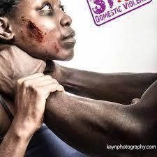
Background
For every 1,000 women between the ages of 15 and 19, 150 of them have at least been victimized in Haiti, the highest proportion of any other age group..

Slide 4


Problem
- Deterioration of the quality of life
-Attempted murder
-Interruption of daily activities
- Perpetuation of women's low status and poverty
These consequences of domestic violence are problems to which our project wants to try to find a solution..

Slide 5

Audience
All young women and girls
Associations working against violence against woman
The different institutional and associative partners

Slide 6
Data source
EMMMUS-IV
2016-2017:
Data were collected on EMMUS –VI (Survey on Mortality, Morbidity and service utilization in Haiti) among 9795 people in Haïti.

Slide 7

Methodology
Collecting data from EMMUS
Cleaning data and EDA using Python and Pandas and Numpy
Building a Machine Learning Classification Model with Python
Making Recommendations to the different sectors fighting against domestic violence.

Slide 8
Question of research
How can an abused woman continue to live a normal life?
How to accompany women victims of violence?

Slide 9
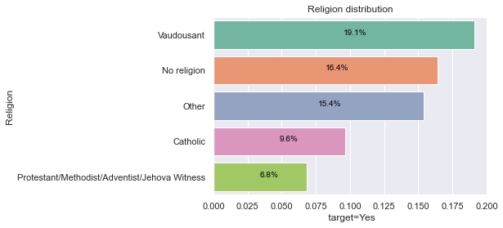
Woman Beating
Women who are Voodooists, No religion, Other, Catholic and Protestant/Methodist/Adventist/Jehovah Witness are much more victims of domestic violence.
We can also see that the Voodooists and the Others are 2 to 3 times more victims than the Catholics and the Protestants.

Slide 10
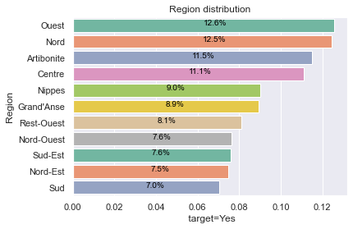
Region Distribution
Taking into account the first 3 regions, that women who are from:
West:
North:
Artibonite:
are much more victims of domestic violence.
We can therefore say that women from Artibonite, West and North are twice as much victims as the other regions.

Slide 11
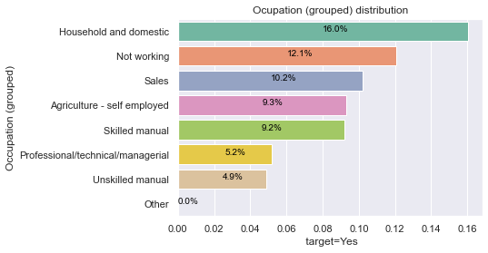
Occupation (grouped) Distribution
In terms of occupation, women who are Household and domestic, Not working, Sales, and Agriculture-self employed are more victims of domestic violence.
We can also see that this is the highest proportion compared to the other occupation groups.

Slide 12
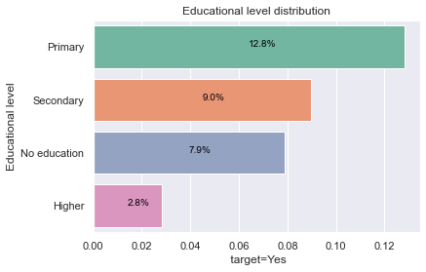
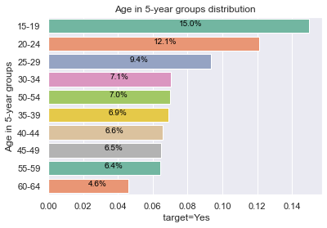
Educationnal level - Age in 5-year groups distribution
Analyzing this graph, we can see that women of primary, secondary and no education level are 3 times more beaten compared to those of higher education level.
women who are in the age group: 15-19 and 20-24 are the most beaten.

Slide 13
Machine Learning loading

Slide 14
Keys Variables
Variables uses are percentage of youth woman:
Educational level
Religion
Region
Ever been married or not
Occupation
Beating

Slide 15
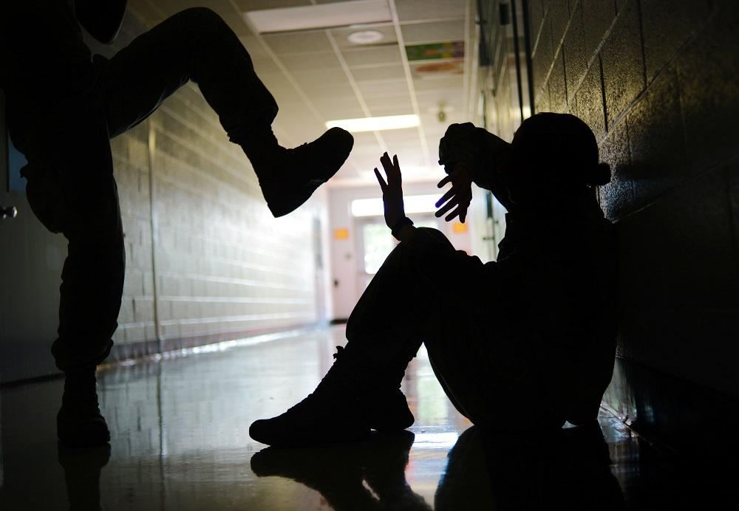
D
o
m
e
s
t
I
c
V
i
o
l
e
n
c
e

Slide 16
My finding
According to the data
The mean age of Beating justified: wife refuses to have sex with husband is 30.29; and 3% of them are victims.
The mean age of Beating justified: wife neglects children is 26.51; and 5% of them are victims.
The mean age of Beating justified: wife goes out without telling husband is 29.31; and 6% of them are victims.
The mean age of Beating justified: wife argues with husband is 27.02; and 1% of them are victims.
The mean age of Beating justified: wife burn food is 28.16; and 2% of them are victims .
15%, 12%, 9% of battered women are successively of the following age groups: 15-19, 20-24, 25-29 years old;
12.6%, 12.5%, 11.5% of them are from the religion: North, West and Artibonite;
12.8% of them have no primary education;
Of these women, 10% are victims of domestic violence.

Slide 17
Solution
Intensify public awareness compaigns, especially those aimed at men.
Enjure that justice systems continue to prosecute perpetrators

Slide 18
CONCLUSION
Violence makes victims feel fear, guilt, shame and isolation. These reactions are normal, it is the situation that is not. This leads to major problems: stress, anxiety, depression, insomnia, etc. Violence destroys well-being and degrades health. All aspects of life are affected: family, work and social life.
Let's say "NO" to Domestic Violence.

Slide 19
References & Appendices
Link of the project’s GitHub repository:
https://github.com/kettenieF20/Final-Capstone-Project

Slide 20


Thénéus Ketenie Flore
Manager to be
Data Analayst to be
ketteniefloretheneus@gmail.com
+509 36299266\ 43766153
Thank you!

